Slide 1

Team: Money
IT5007: Course Project
Wong Chee Weng
Gary Ng

Slide 2
Introduction
Data in the financial ecosystem are abundant, yet by some estimates “businesses use only 0.5% of available [financial] data (source).”
We observe that there are plenty of data providers in the industry, yet few who are willing or able to clean, process, and interpret the data.
Most financial firms who are without world-class resources rely on their quantitative researchers or business analysts (usually 1-2 hires) to build infrastructure, ingest raw data, preprocess, and churn out research results.
Researcher productivity is sub-optimal as they tire from constantly ingesting and organizing new datasets leaving little time for data processing and research.

Slide 3
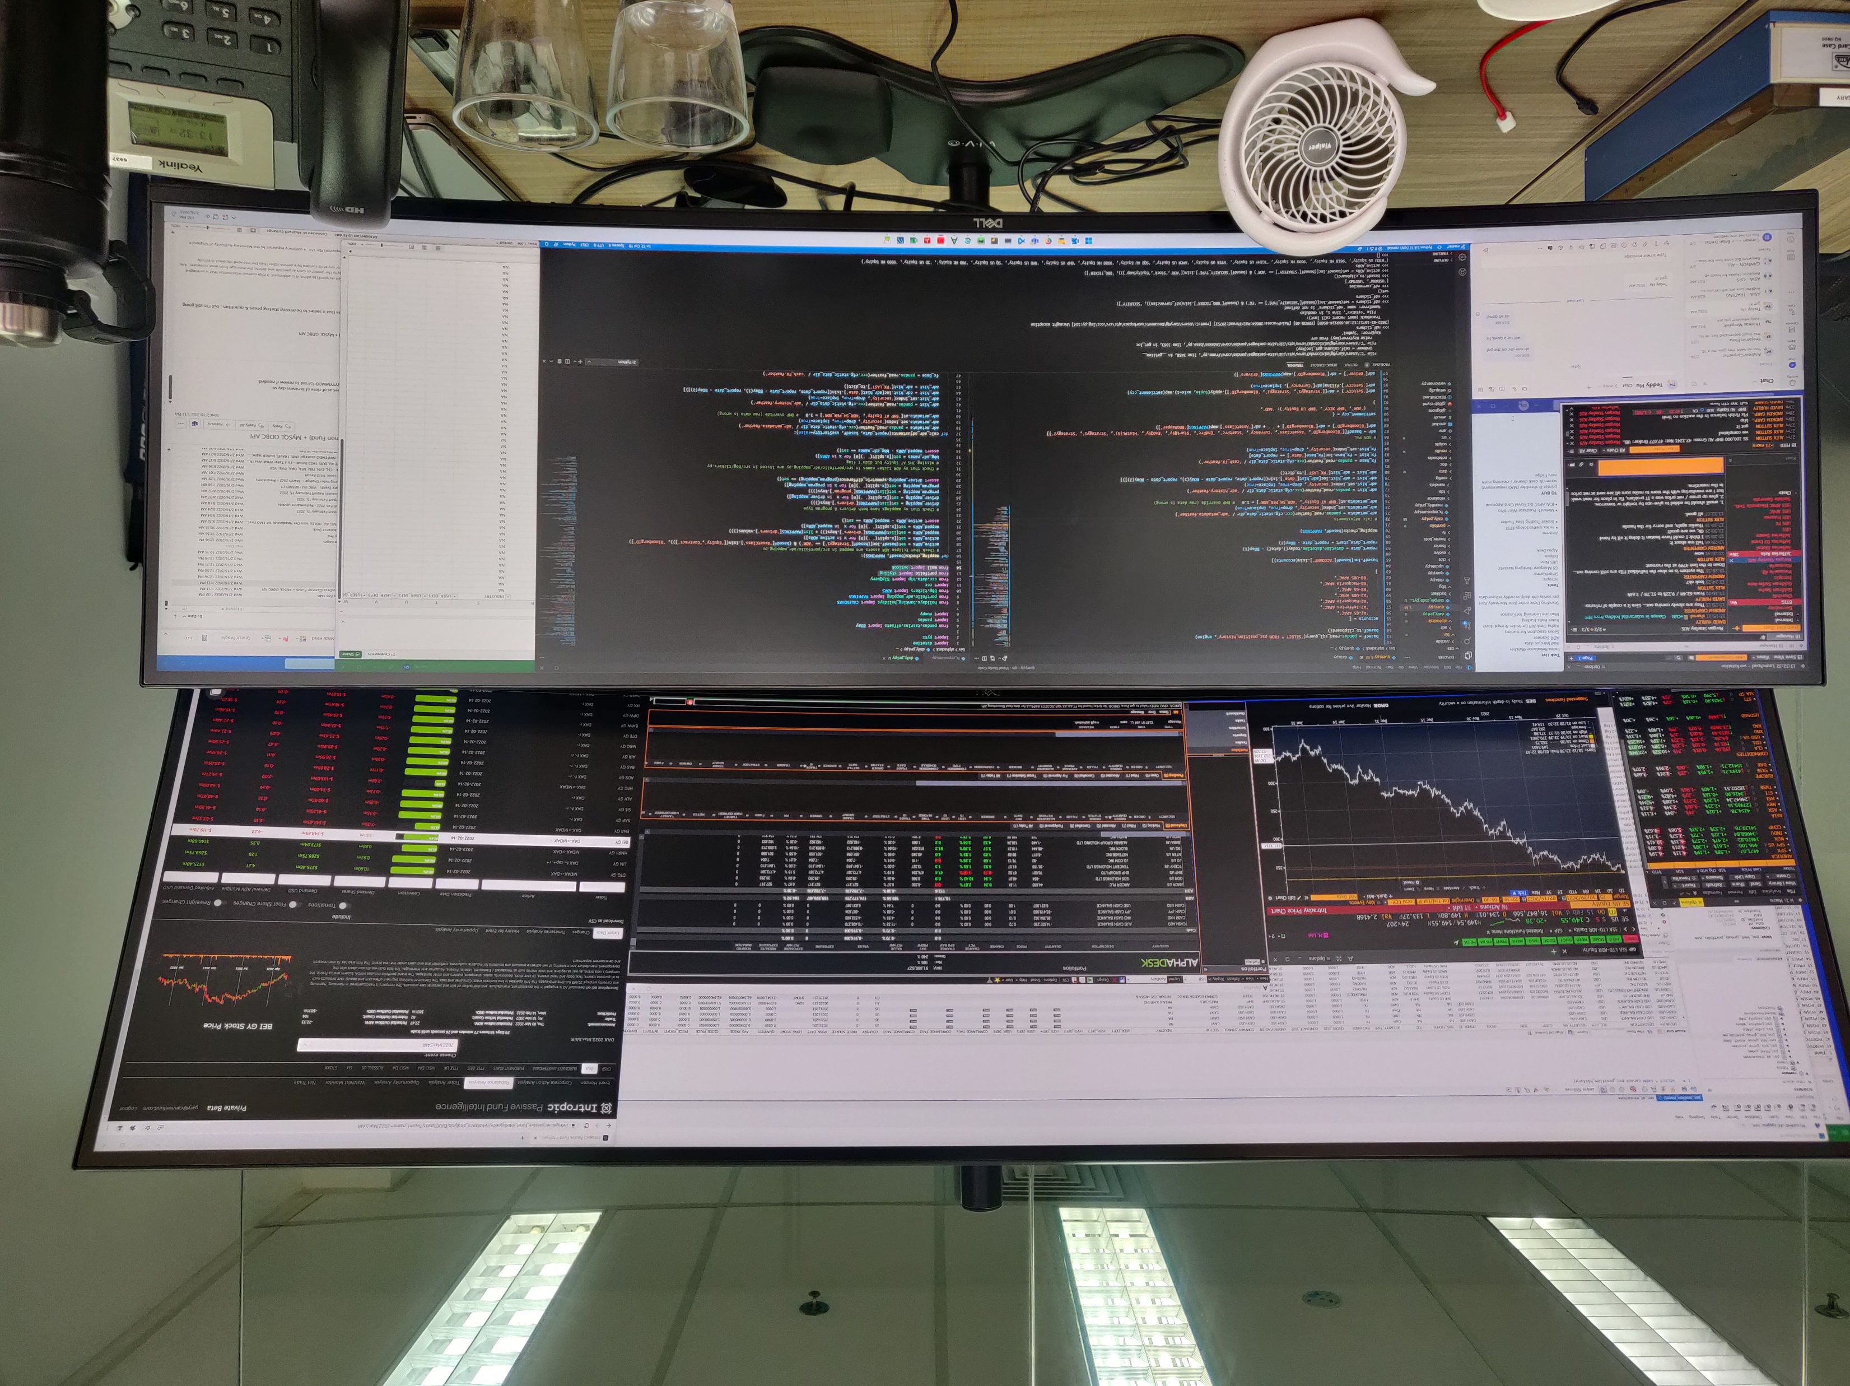

Slide 4
Problem Statement
Financial data is messy. Quantitative Researchers require a defined framework to ingest and organize multiple datasets so that they may present research results in an accurate, informative, and interactive manner.

Slide 5
What We Want to Achieve
Back-End: Framework for Multiple Datasets
Design and develop a flexible and scalable software architecture solution that houses diverse datasets such as:
1. Market Data (Historic Prices - Bloomberg)
2. Portfolio Management Data (Current Portfolio Positions – Eze Eclipse Risk Management System)
3. New Research Ideas (Sell-Side Bank Research Ideas)
Middle: Quantitative Researcher’s Workspace
An environment where the researcher may query data, apply (in this case) a basic data analysis technique, and finally output research results.
Front-End: Informative & Interactive
A dashboard that draws upon the raw data and research results to display all relevant data in an insightful and useful manner.

Slide 6
What We are Not Doing
We are NOT working on a project to develop a profitable trading algorithm.
We are NOT … (tbd)

Slide 7
Diving into the Details

Slide 8
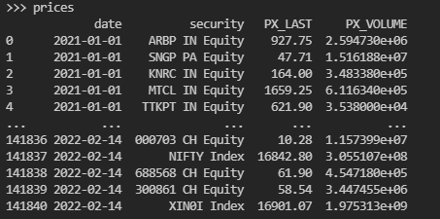
Input 1.1 – Historical Financial Data
Source: Bloomberg
Format: CSV

Slide 9
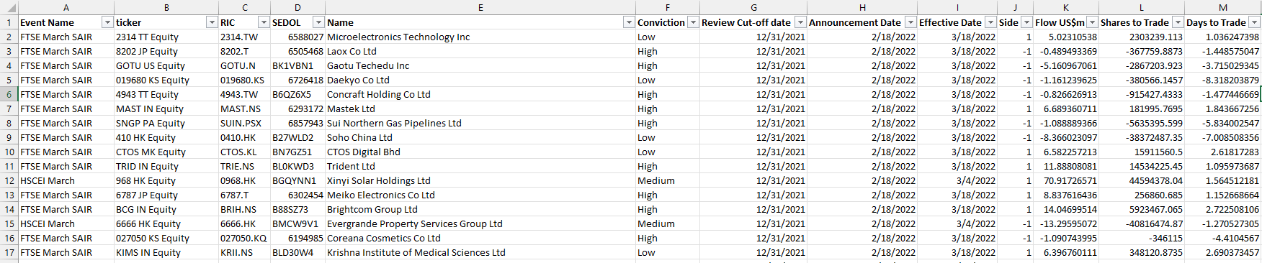
Input 1.2 – Data Provider #1
Type: Analyst’s Recommendations
Format: Excel

Slide 10
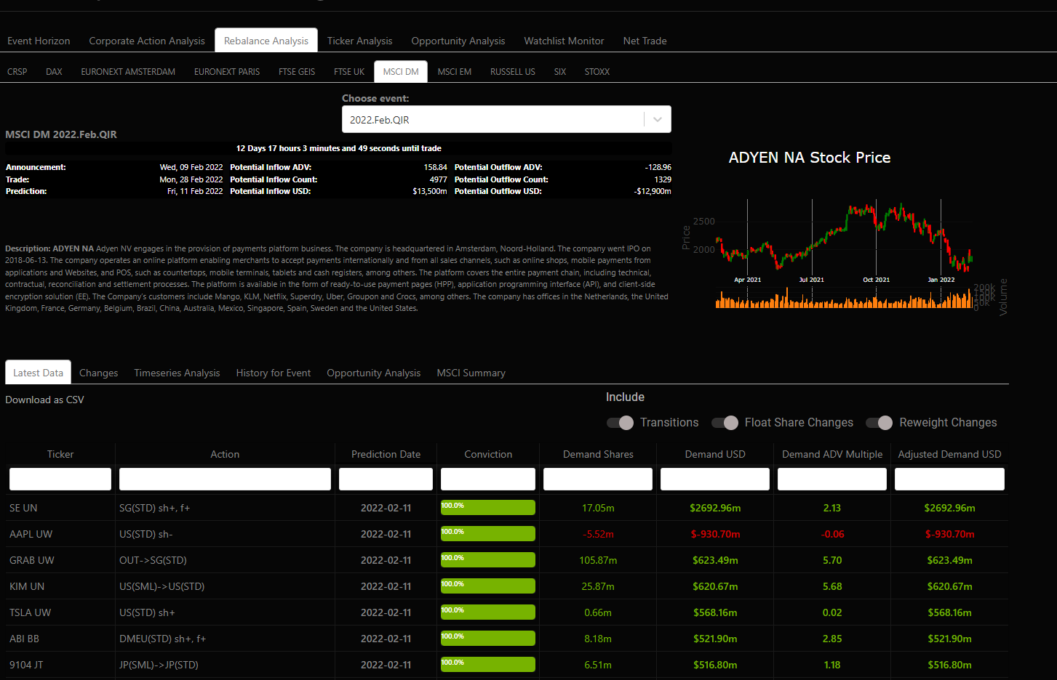
Input 1.3 – Data Provider #2
Name: Intropic Intelligence
Type: Third-Party Software
Format: CSV

Slide 11
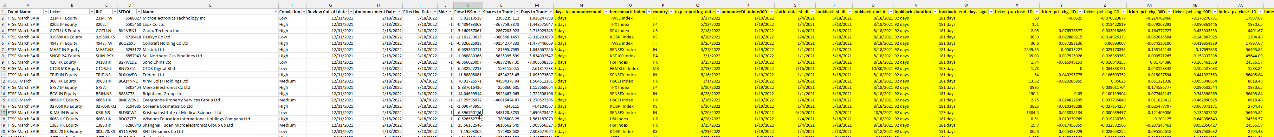
Step 2 – Our Workspace
Using Python, this will be the time where we merge multiple data sources together and apply data analysis techniques and transformations to add value and context to the trading recommendations.

Slide 12
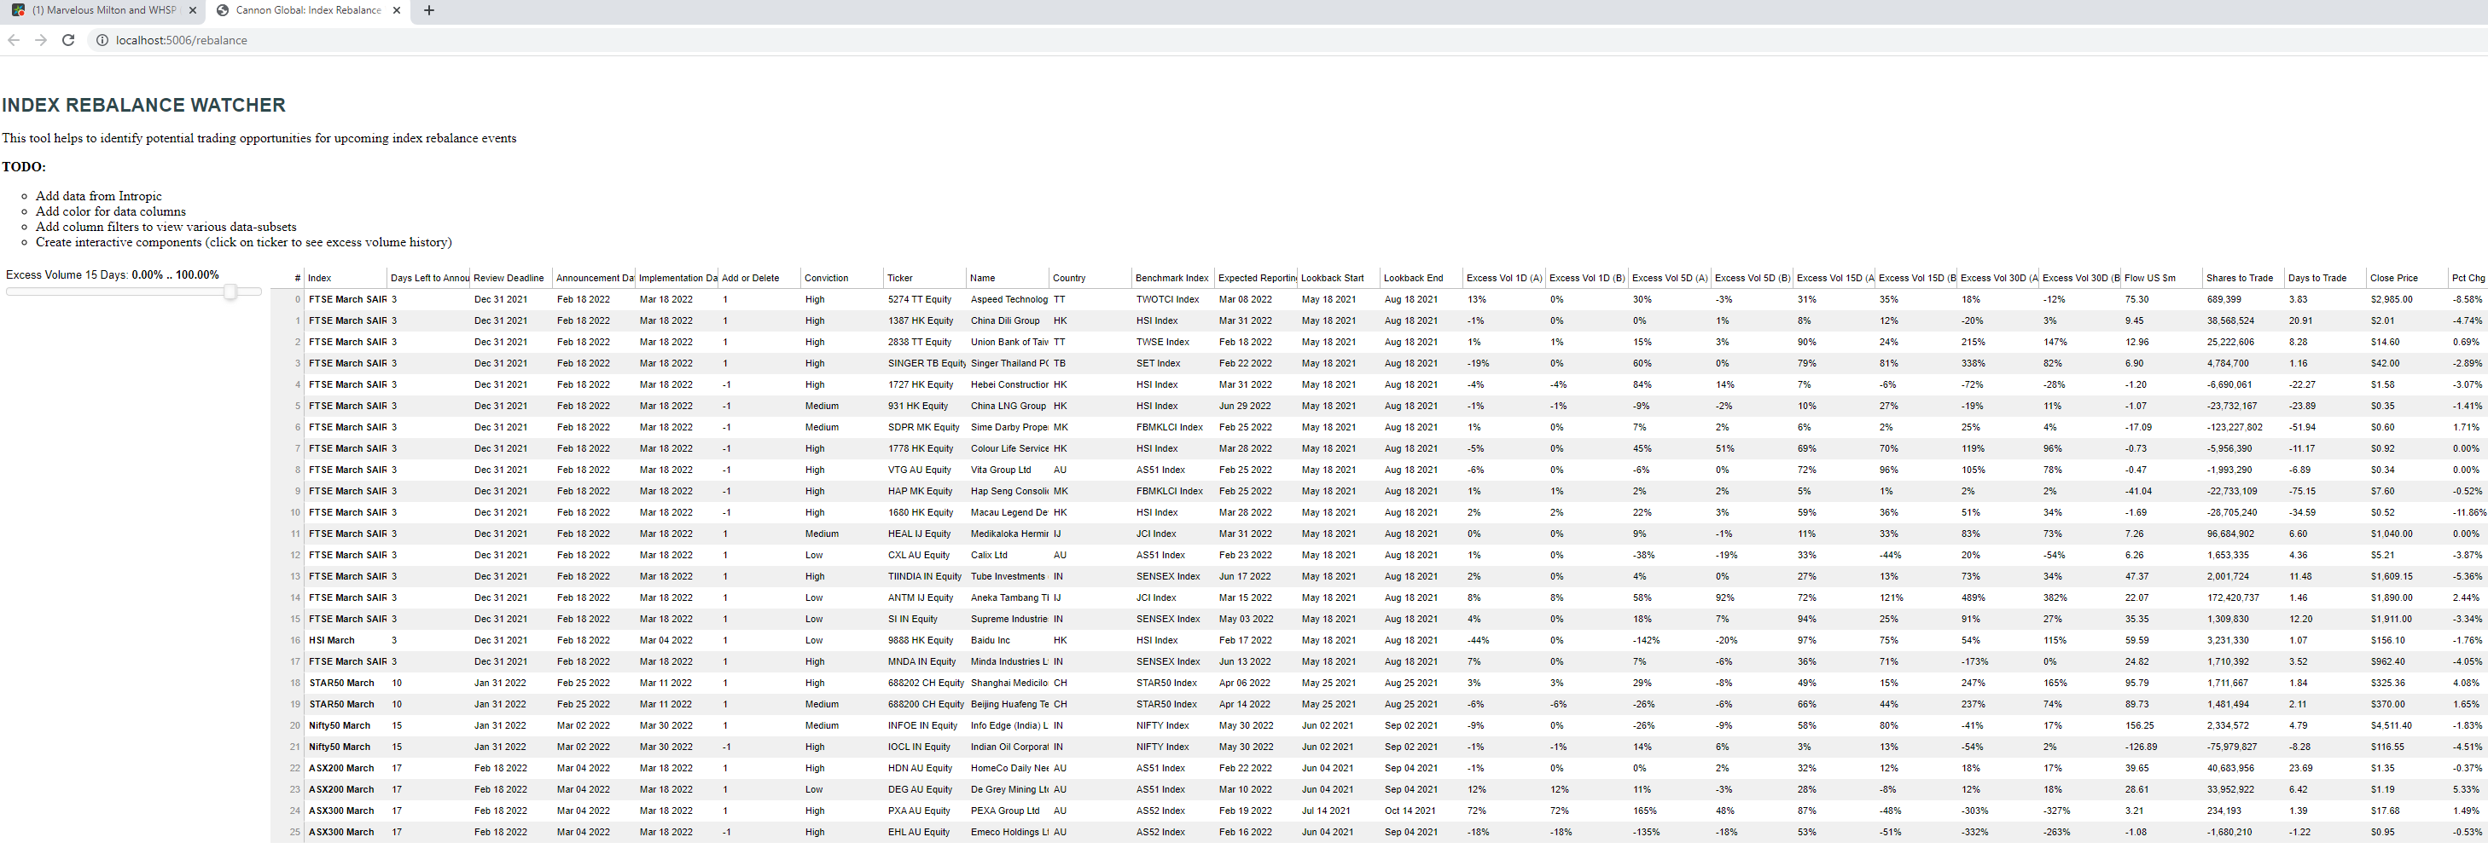
Step 3 – Final Output
While not pretty, the so-called processed results are displayed on a web UI.
We should use the MERN stack for this part, add colors and other useful visual indicators.

Slide 13
Feature #1: Sorting & Filtering
Like in Excel, we want to be able to interact with the homepage to sort and filter the data for items of interest.

Slide 14
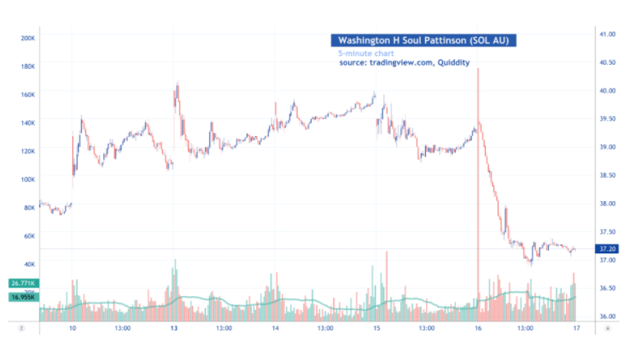
Feature #2: Charting
We want to be able to interact with the home page, click on a line item (a stock of interest) and have it generate a simple historical price chart as illustrated here.

Slide 15
Feature #3: Output
Finally, we can say the front-to-end project is complete by providing a feature where the trader can select (shortlist) a line item to “add to basket” (using a checkbox).
There will be an export button which generates the daily trading basket which is a csv that has all the shortlisted items, quantities, stock name, and other important details for the trader to proceed onto trade.

Slide 16
